Slide 1
FWD Project
TOGAF 9 - Core Diagrams
Platform Decomposition Diagram
Phase D – Technology Architecture

Slide 2
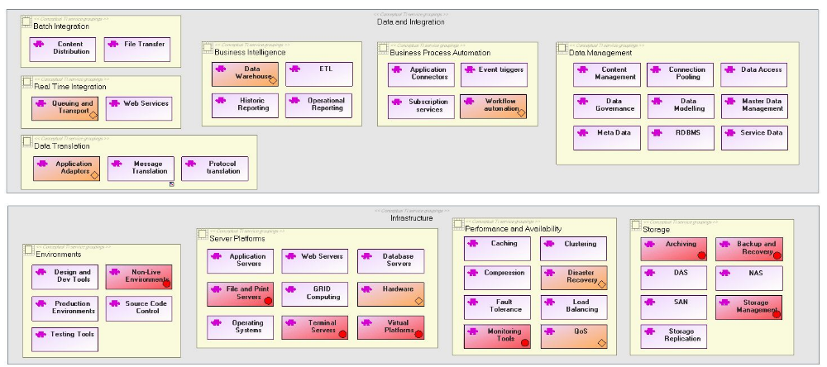
Platform Decomposition Diagram

Slide 3
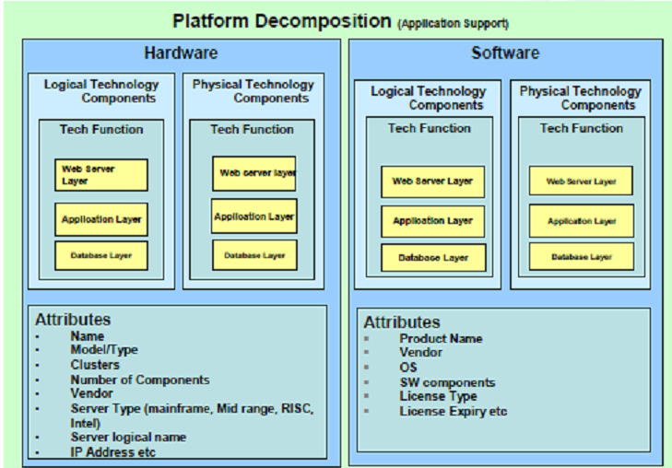
Platform Decomposition Diagram

Slide 4
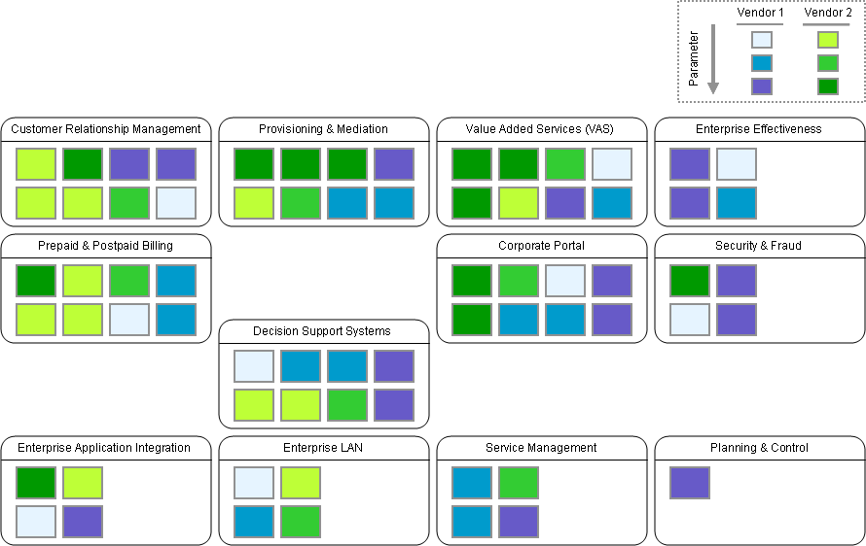
Platform Decomposition Diagram

